Slide 1


Do Layoffs Pay Off?
Analyzing the Financial Aftermath of Workforce Reductions.
By Jared Arvind Balakrishnan, Dhevin De Silva & Michelle Barabasz

Slide 2

Agenda
01
Introduction
02
Quick Facts
03
Financial Ratios and Metrics
04
Analytical Approaches Followed
05
Findings and Implications
06
Conclusions

Slide 3

Introduction

Slide 4

Why Focus on Layoffs?
1. Economic Impact: Layoffs affect the economy by raising unemployment rates and influencing consumer confidence and spending. Understanding these effects helps inform decisions to stabilize or stimulate economic growth.
2. Corporate Health and Sustainability: Examining the financial outcomes of layoffs reveals their impact on a company's long-term viability. It's vital to assess whether short-term savings justify potential long-term drawbacks like decreased morale, innovation, and loss of skilled employees.
3. Employee Well-being and Social Stability: Layoffs profoundly affect employee well-being and workplace stability. Investigating these impacts can improve management practices and support systems, fostering a more stable and supportive work environment.
Notes:
1. **Economic Impact**: Layoffs have a direct effect on the economy, not only through the increase in unemployment rates but also by influencing consumer confidence and spending. Understanding the financial aftermath helps policymakers and businesses make informed decisions that could stabilize or stimulate economic growth during downturns.
2. **Corporate Health and Sustainability**: Analyzing the financial outcomes of layoffs can reveal how such decisions affect a company's long-term sustainability. It's crucial to determine whether the immediate cost savings justify potential long-term drawbacks like decreased morale, reduced innovation capacity, and loss of skilled employees.
3. **Employee Well-being and Social Stability**: Layoffs can have profound effects on the well-being of employees, both those laid off and those who remain. Exploring these impacts can lead to better management practices and support systems that mitigate negative consequences, promoting a more stable and supportive work environment.

Slide 5
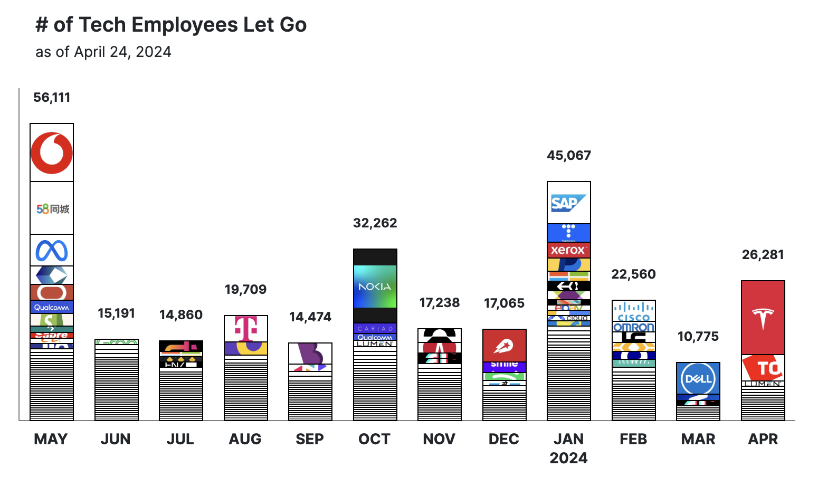


Layoffs in the Tech Industry
Why? The recent (seemingly unending) surge in layoffs in the tech industry seems to go against the popular adage “Software is eating the world”
Context: Some of these companies have established themselves as pivotal players in the stock market, and are seen as coveted places to work for in a young person’s career. Is it going to be the same? Is it worth it?
Approach: Utilizing comprehensive data analysis and financial metrics, we will examine the immediate and prolonged impacts of layoffs on company performance, employee morale, and market perception.
Notes:
In recent years, the tech industry has witnessed a significant flux in workforce management, with layoffs becoming a frequent strategy for companies aiming to optimize operations and manage financial resources. This trend has sparked a wide range of discussions about the economic and social impacts of such decisions, particularly as they affect some of the largest and most influential companies in the sector.
Layoffs, often seen as a last resort during economic downturns, have increasingly been used in the tech industry not just as a reaction to financial distress, but also as a proactive approach to anticipated market changes, technological advancements, and shifts in corporate strategy. Companies like those in the FAANG group (Facebook, Apple, Amazon, Netflix, Google) have made headlines with substantial workforce reductions, despite their substantial market influence and capital.
The data concerning layoffs in tech reveals patterns that are worth investigating to understand the broader implications. These include immediate financial effects such as cost savings and stock price reactions, as well as long-term impacts on company culture, employee morale, and innovation capacity. By analyzing these patterns, we can begin to comprehend the real price of layoffs beyond the apparent financial savings, examining whether they genuinely pay off and under what circumstances they might do so.
As this presentation unfolds, we will delve deeper into the financial aftermath of workforce reductions, supported by rigorous data analysis and case studies, to provide a comprehensive view of the strategic role layoffs have come to play in the tech industry.

Slide 6





Data Used
COMPUSTAT Capital IQ Data Used (2020-2024)
Fundamentals - Annual, filtered to FAANG + Microsoft and Tesla
Fundamentals - Quarterly, filtered to FAANG + Microsoft and Tesla
Securities - Daily, filtered to FAANG + Microsoft and Tesla
External Sources of Data Used
U.S. Federal Interest Rates from 2019 to 2024, from FRED (St. Louis Fed)
FAANG Companies’ Earnings Reports from 2020 to 2024 (for verification only)
Worldwide Technology and Startups Layoffs Data from Layoffs.fyi
U.S. Employee Layoff Data from Publicly Available WARN Notices

Slide 7
Quick Facts

Slide 8
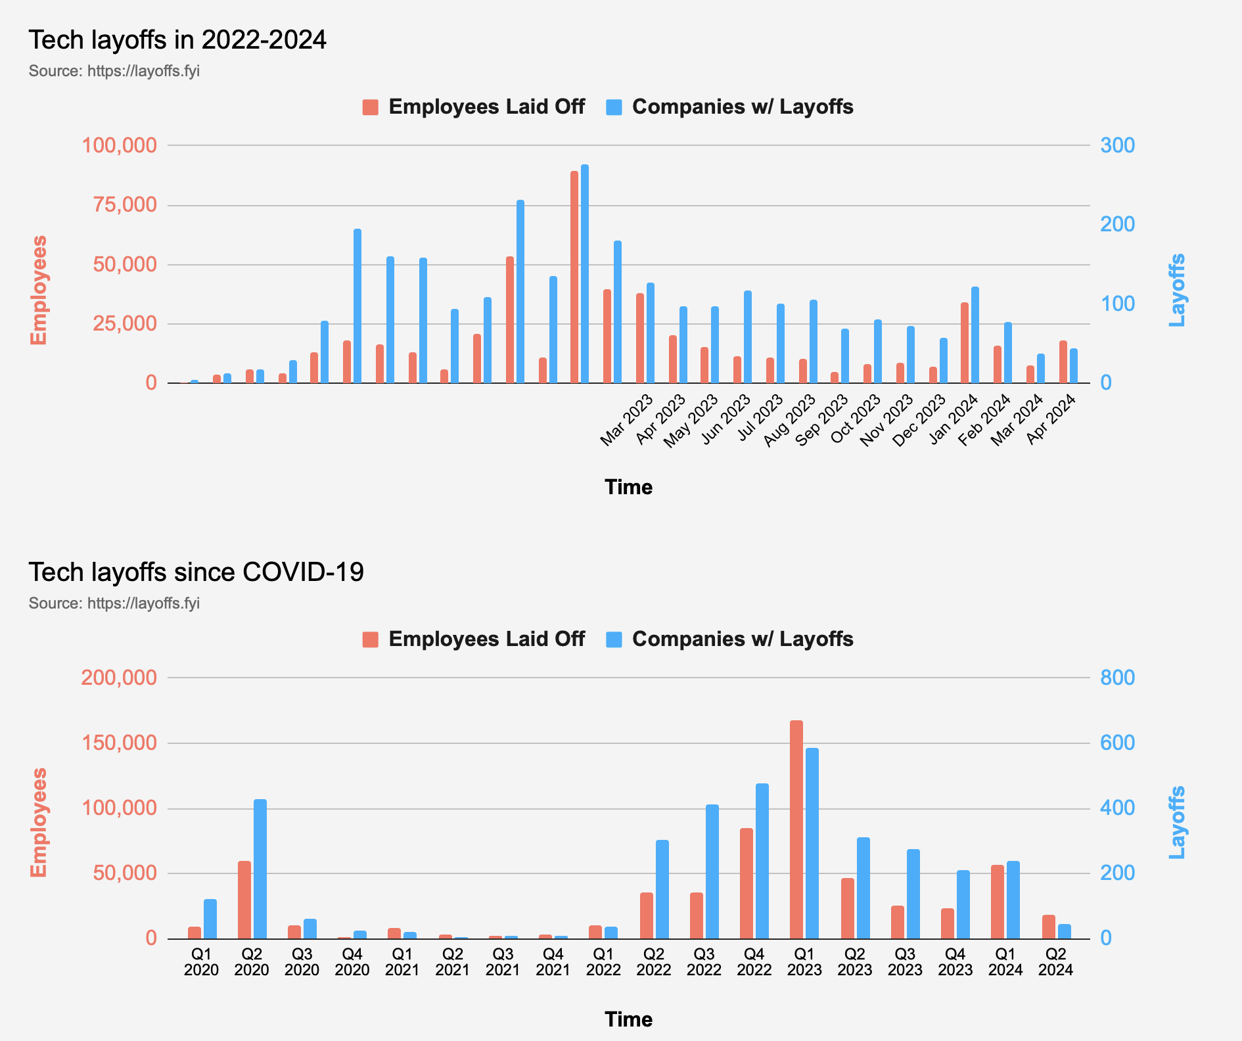
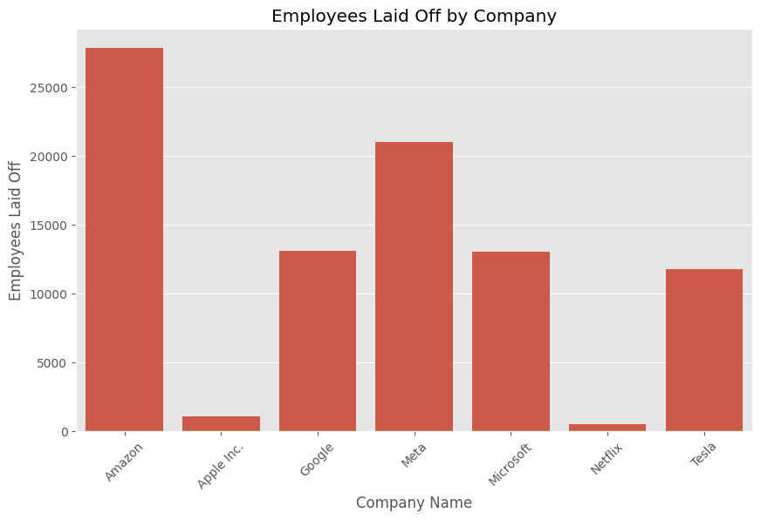
Quick Facts
2560 Tech Companies around the world have executed layoffs in just the last 3 years
Over half a million employees have lost their jobs in the same time period
Apart from Amazon, no FAANG company had EVER executed mass layoffs before 2022
These FAANG Companies would go on to fire almost 90,000 workers in the last 5 years
Layoffs are a costly affair - Meta spent almost $88,000 per laid off employee in 22-23
Startups using or raising venture debt are the worst affected players the past 4 years

Slide 9
Financial Ratios and
Metrics Calculation

Slide 10
Data Normalization and Preprocessing
1. Importing Data and Initial Setup
3. Date Normalization & Conversion
Datasets are imported using the pandas package in python.
Check for missing values and outliers.
Convert all date columns to datetime columns for time-series operations.
4. Merging Datasets
Merging Strategy: Using merge_asof for merging layoffs data with financial data based on the closest date without going past it, ensuring accurate matching of events to financial records.
Variable for Merging: Merging was done on datadate from quarterly_faang and Layoff Date from layoffs_warn, using the company ticker.
2. Winsorizing extreme values
Winsorization was applied to the financial ratios by replacing extreme values at the 5th and 95th percentiles with the values at these percentiles.

Slide 11
Financial Ratios and Other Metrics
Ratio | Formula | Significance
Earnings per Share (EPS) | (Net Income-Preferred Dividends)/Average Outstanding Shares | Represents the portion of a company’s profit allocated to each outstanding share of common stock, serving as an indicator of a company’s financial health.
Earnings Before Interest, Taxes, Depreciation, and Amortization (EBITDA) | Net Income+Interest+Taxes+Depreciation+Amortization | Compares the profitability between companies and industries because it removes the effects of financing and accounting decisions.
Operating Margin | Operating Income/Revenue | Measures how much of each dollar of revenues is left over after paying variable costs of production. Is a good indicator of the operational efficiency.
Debt to Equity Ratio | Total Debt/Total Shareholders’ Equity | A higher ratio means the company is more leveraged, relying more on debt to finance its growth, which can increase financial risk.
Return on Assets (ROA) | Net Income/Total Assets | Shows how efficiently a company can manage its assets to product profits during a period.
Return on Equity (ROE) | Net Income/Shareholders’ Equity | Measures how well a company uses investments to generate earnings growth.
Free Cash Flow | Operating Cash Flow-Capital Expenditures | Shows how much cash is available for the company to repay creditors, pay dividends, and make investments.
Current Ratio | Current Assets/Current Liabilities | Measures a company’s ability to pay off its short-term liabilities with its short-term assets.

Slide 12
Analytical Approach

Slide 13
Analytical Methodology for Assessing Layoff Impact
An extensive review of company records from 2020-2024 revealed multiple instances of layoffs.
Various approaches, such as identifying the initial or final layoffs, were evaluated to pinpoint the most significant layoff event for each company.
FINAL LAYOFF METHODOLOGY
For this analysis, the year with the highest number of layoffs for each company was identified as the pivotal layoff period. Consequently, the 'before layoffs' phase refers to the time period leading up to this year, and the 'after layoffs' phase encompasses the time following that year.
Subsequently, we computed the predetermined financial ratios for each company, segregating the data into two distinct segments: preceding and succeeding their respective "layoff period."

Slide 14
Analyzing Data Around Each Layoff Date
EPS AND EBITDA
STOCK MARKET REACTION
Wanted to analyze the changes in EPS and EBITDA around each layoff date.
Was done for 3 companies individually and then for all companies together.
WHY:
Analyzed the variation in Earnings Per Share (EPS) to quantify the impact of workforce reductions on per-share profitability.
Evaluated the fluctuation in Earnings Before Interest, Taxes, Depreciation, and Amortization (EBITDA) to measure operational earnings before non-operating expenses and executive decision-making effects around layoff dates.
Wanted to analyze the changes in stock market reaction around each layoff date.
Was done for 3 companies individually and then for all companies together.
WHY:
Evaluating stock market reaction to layoffs helps determine investor sentiment and the perceived impact on a company's future performance, with individual company analysis highlighting specific market responses and aggregate analysis providing sector-wide trends.

Slide 15
Interest Rates and Layoffs
Objective: Demonstrate the correlation between interest rate changes and the timing and magnitude of layoffs within companies, providing insights into how economic factors influence corporate decisions.
Steps
Sort datasets by their date columns (Layoff Date for layoffs and DATE for interest rates).
Merge layoff data (Layoff Date) with interest rates data (DATE) using AsOf Merge to match each layoff to the most relevant interest rate that is on or before the layoff date.
The merged dataset is filtered to include data starting from January 1, 2019.
Plot the two data points – the number of layoffs and the federal interest rates - on one plot to visualize the relationship.
Why is this analysis important?
High interest rates can increase borrowing costs, leading to reduced investments and potentially causing companies to lay off employees to cut costs. Analyzing the timing and frequency of layoffs against interest rates can provide insights into how macroeconomic factors affect corporate decisions.

Slide 16
Findings and Implications

Slide 17

Comparing Financial Ratios
While financial ratios were calculated for all companies, we will focus on presenting the results for Google, which had the most amount of layoffs in 2023. Here are the comparisons:
Financial Metric (Average) | Pre-Layoff | Post Layoff
EPS | 17.56 | 1.47
EBITDA | 21,127.42 | 24,538.00
Operating Margin | 0.32 | 0.32
Debt to Equity | 0.40 | 0.43
ROA | 0.09 | 0.11
ROE | 0.06 | 0.07
Free Cash Flow | 32,814.83 | 46,828.00
Current Ratio | 3.02 | 2.17
Google's Average EBITDA increased and the Return on Assets (ROA) improved, suggesting a substantial enhancement in profitability and asset efficiency post-layoff. Additionally, Google's Free Cash Flow saw a significant rise, indicating improved financial flexibility and operational efficiency following the layoffs.

Slide 18
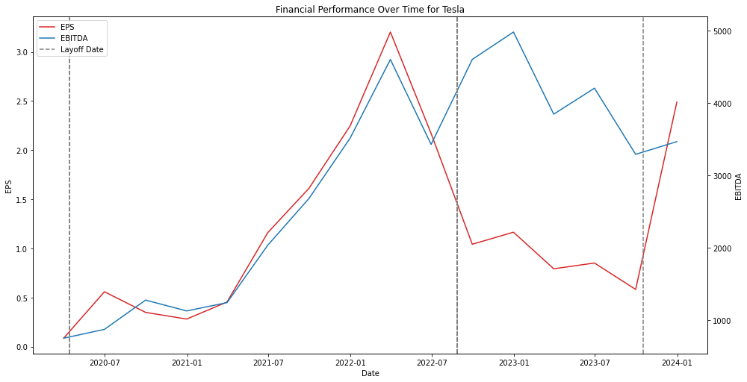
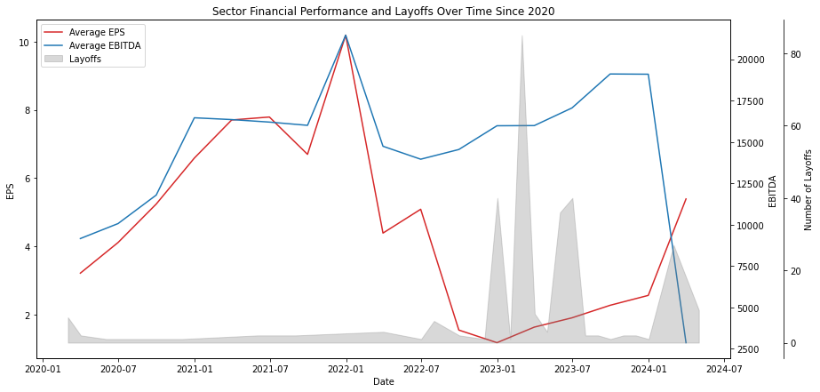
Analyzing Data Around Layoff Dates
Results from Tesla:
Results from all companies:
Insights:
A consistent increase in both EPS and EBITDA is observed leading up to the layoff date.
A slow decrease in EPS is seen immediately after the layoff date after the second layoff late, but a sharp increase is seen after the third layoff date.
EBITDA seems to not drop as much after the layoff date.
The layoff event is marked by a significant impact on financial performance, indicating a possible correlation.
Insights:
There is volatility in average EPS over time, with notable dips and recoveries around the layoff periods.
Average EBITDA also shows fluctuations, but with a different pattern compared to EPS, suggesting different factors may affect EBITDA.
Layoff events appear to coincide with notable changes in financial metrics, which could imply a connection between layoffs and financial performance.
Notes:
cant say definitely

Slide 19
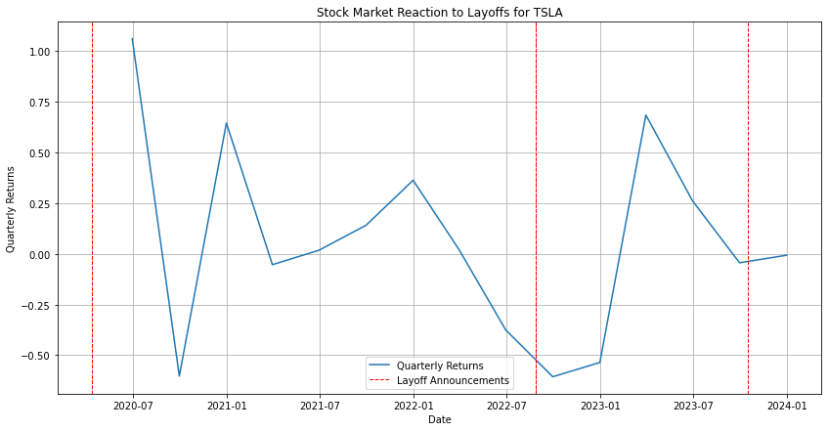
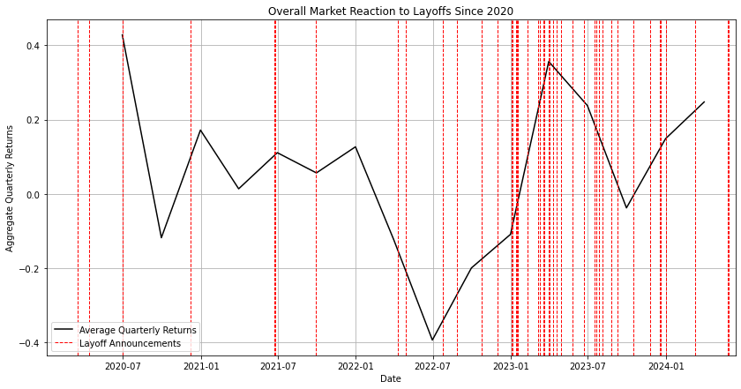
Stock Market Analyses Results
Results from Tesla:
Results from all companies:
Insights:
The reaction to some layoff announcements appears positive with an increase in quarterly returns, suggesting investors may perceive the layoffs as a favorable restructuring move.
However, there's also a visible drop in returns following other announcements, indicating potential investor concern or negative sentiment.
Insights:
The plot suggests that the market does not react uniformly to layoffs, pointing to a complex interplay of factors influencing investor sentiment.
Fluctuations in returns around layoffs suggest investor reactivity to such events.
Clusters of layoffs seem to prompt stronger market responses, reflecting sensitivity to employment trends.

Slide 20
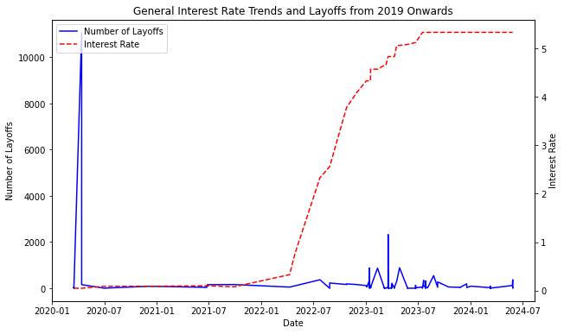
Interest Rates and Layoffs
The spike in layoffs during a period of low interest rates is an anomaly, exclusively attributed to an incident at Tesla
The U.S. Federal Reserve lowered interest rates during the SARS nCOV-2 Pandemic
The cost of debt is much lower during a period of low interest rates, allowing companies to spend a lot and hire a lot
Inflationary pressures caused the Fed to raise rates rather dramatically, from ~0% to ~5%
Cost of debt suddenly skyrocketed, and companies didn’t have the ability to access debt at the same level
Consequently, they resorted to layoffs as a cost-cutting measure
There’s a clear relationship between periods of high interests and executions of mass layoffs*,**
*now immortalized by the term ZIRP
** this is a major reason why so many startups (even unicorns) experiencing hyper-growth went under, got acquired, or worse, resorted to raising down rounds

Slide 21

Meta’s “Year of Efficiency”: Do Cost-Cutting Measures Actually Work?
A Brief History of Time
Founded January 2004 by Mark Zuckerberg
Files S-1 to go public on January 1, 2012 and goes public on May 18, 2012 at $38.23 per share
Becomes a blue-chip stock, hitting an all-time high of $378 in September 2021
Also doubles headcount from 2019-22
Stock Price craters down to $90 on November 4, 2022
Executes first-ever mass layoffs in company history on November 9, 2022
Executes a second mass layoff event on March 14, 2023 citing “Year of Efficiency”

Slide 22
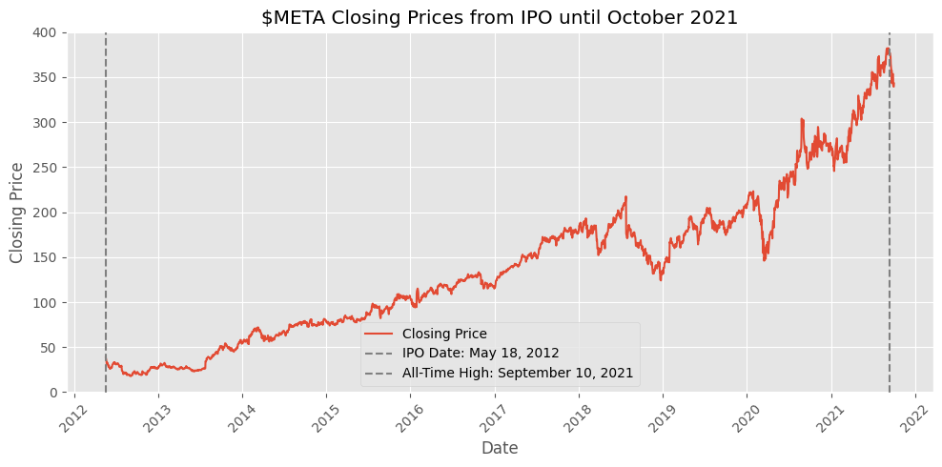
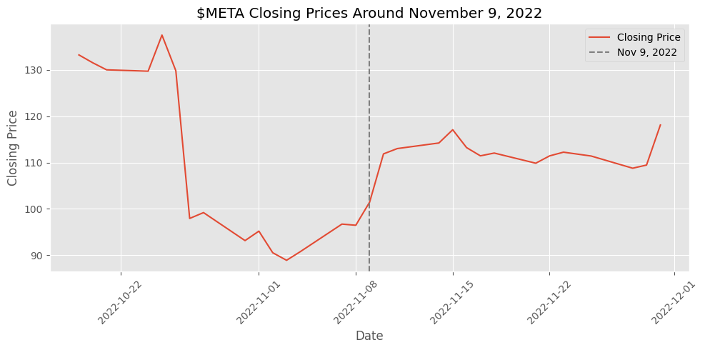
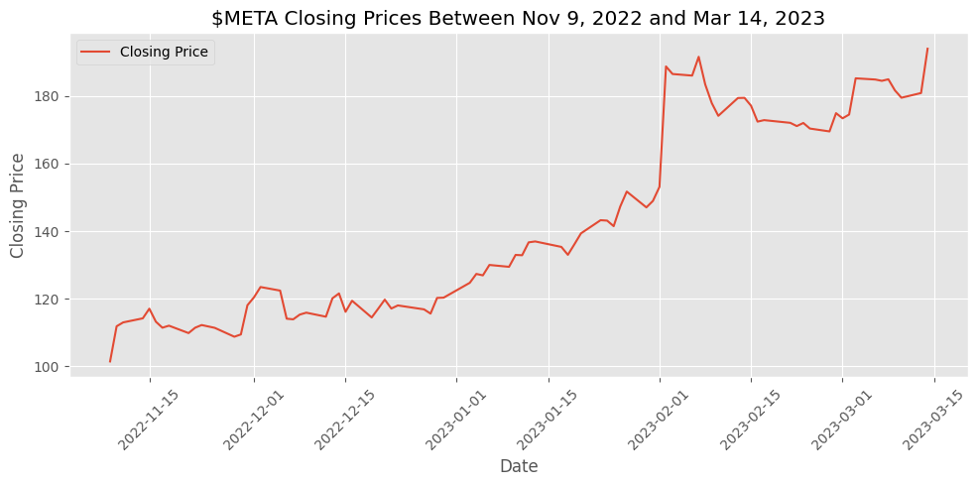
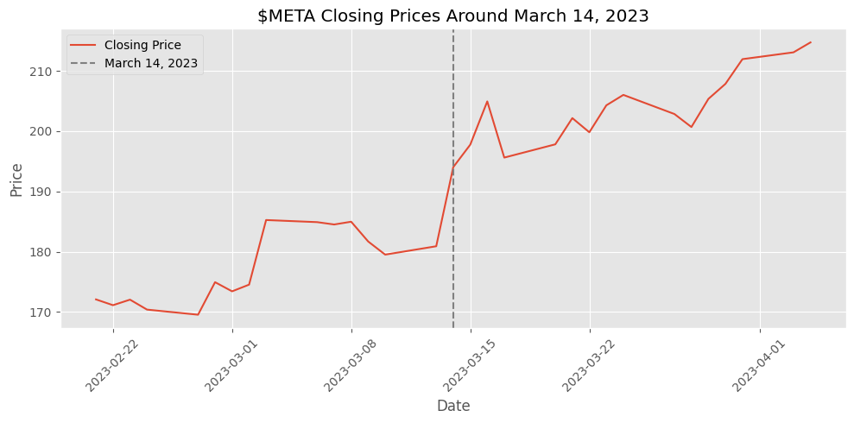
A Story in 4 Charts

Slide 23
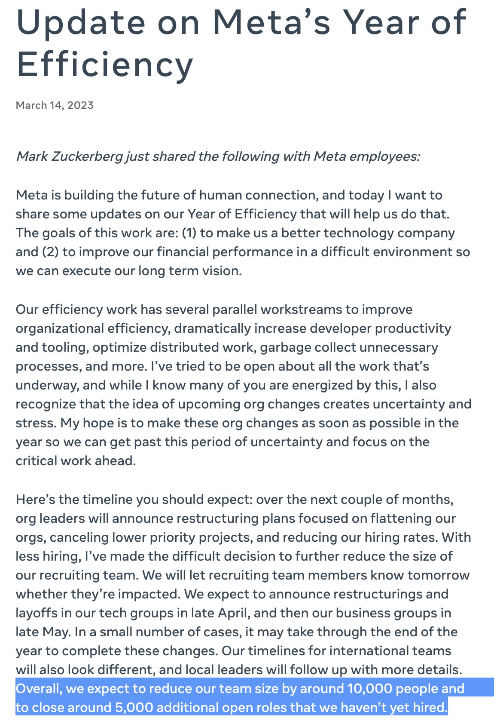
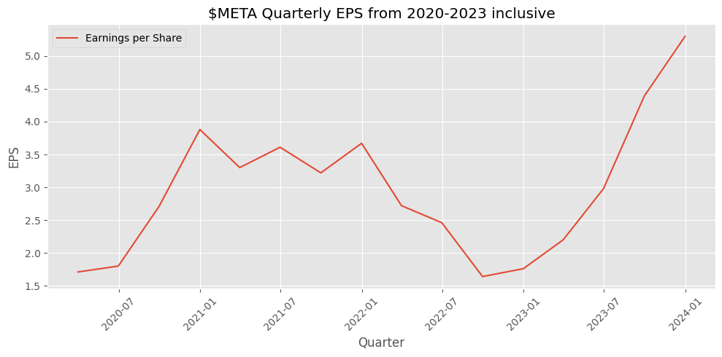
Did it Work?
Share Prices and eps seem to have rebounded spectacularly
$META has added over $360bn in market cap since the layoffs unfolded
The share price has increased from ~$90 to ~$500 now

Slide 24
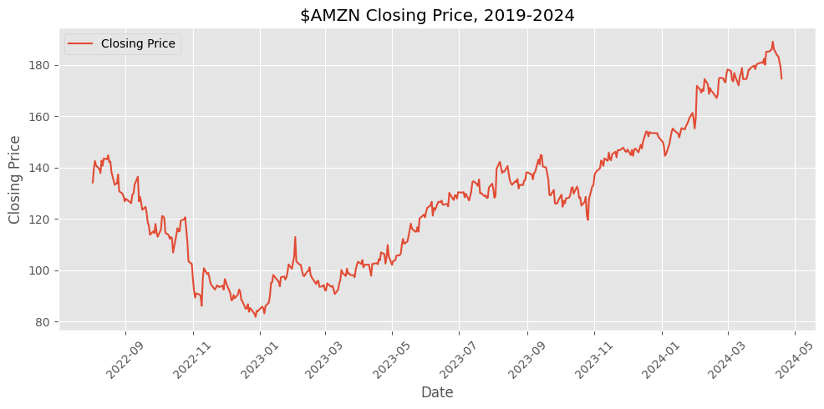
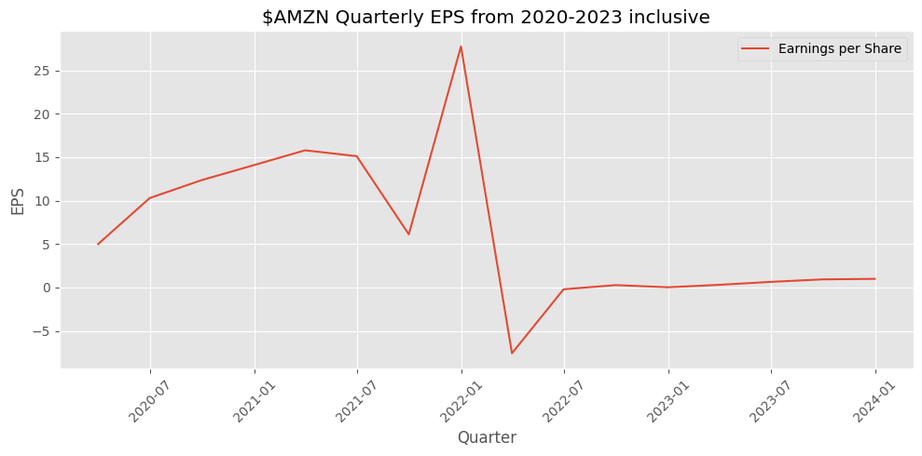
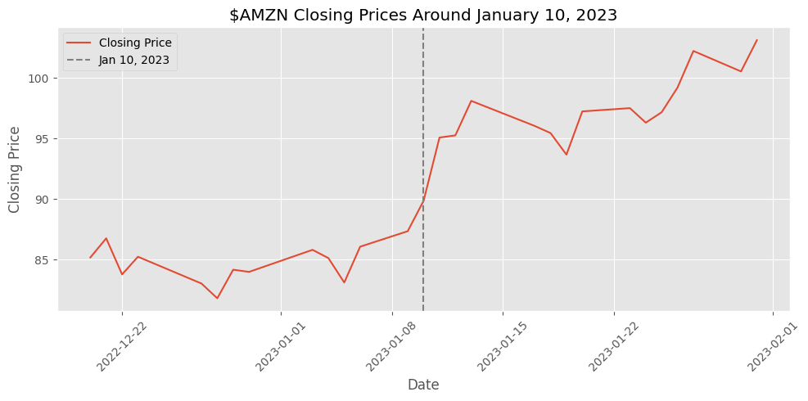
Unfortunately…
It doesn’t seem like Meta is the norm; rather the exception
Amazon executed multiple rounds of mass layoffs around the same time, resorting to more extreme cost-cutting measures
Things look good on paper: stock is up by a lot!
However, if not for the AWS Cloud business, the financial outcome doesn’t seem the brightest…

Slide 25
Conclusions

Slide 26
Conclusions
In the case of established companies, layoffs seem to lead to a rebound in stock prices
This is in contrast to the negative perceptions surrounding the human aspect of layoffs
Market/Investor sentiment seem to view layoffs as a “fresh start”
However, the post-layoff performance of a company cannot be definitively said to improve drastically after layoffs
This is very important since it points to the high degree of subjectivity in analyzing the impact of layoffs
Each company needs to take a deep look inwards if their performance is to really improve post-layoffs
Notes:
Economic Implications:
1. Unemployment and Economic Stability:
- Layoffs contribute to higher unemployment rates, which can destabilize economic conditions by reducing consumer confidence and spending. This, in turn, may necessitate policy interventions aimed at economic stabilization or growth stimulation to counteract the negative effects.
2. Impact on Financial Markets:
- Layoffs can lead to volatility in financial markets, as observed in the stock market reactions. Positive reactions may occur if layoffs are perceived as beneficial restructuring efforts to improve operational efficiency. Conversely, negative reactions can arise from concerns over the company's future viability.
3. Interest Rates Correlation:
- The study suggests an inverse relationship between interest rates and layoffs. Lower interest rates might encourage layoffs as companies take advantage of cheaper financing to restructure during economically favorable conditions. Conversely, rising interest rates may discourage layoffs by increasing the cost of borrowing.
Business Implications:
1. Long-Term Corporate Health:
- While layoffs may provide immediate financial relief, they often have long-term consequences that can affect a company's health. Potential negative impacts include decreased morale, innovation, and the loss of essential skills, which could undermine long-term business sustainability.
2. Market Perception and Investor Sentiment:
- The perception of layoffs by market participants can significantly influence a company's market valuation. Fluctuations in quarterly returns around the time of layoffs highlight the sensitivity of investors to such corporate restructuring moves.
3. Operational Efficiency vs. Employee Well-being:
- The need to balance operational efficiency through layoffs with maintaining a supportive work environment is highlighted. This balance is crucial as layoffs can significantly impact employee morale and workplace stability, which are essential for long-term productivity and innovation.

Slide 27
THANK YOU

Slide 28
Project Split
Person | Task | Percentage Contribution
Jared | Datasets, EDA, research | 33%
Michelle | Ratios calculations, analytical approach code | 33%
Dhevin | Data, results, business implications, entertainment | 33%

